Slide 1
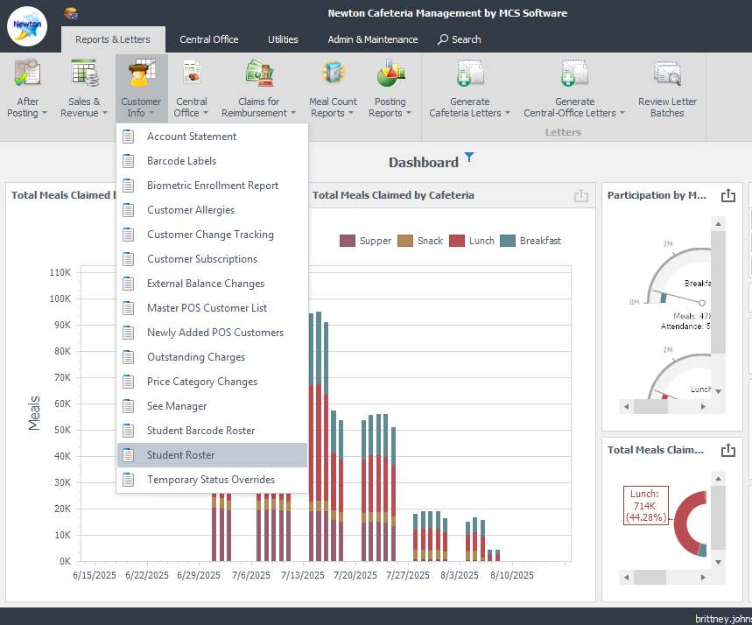
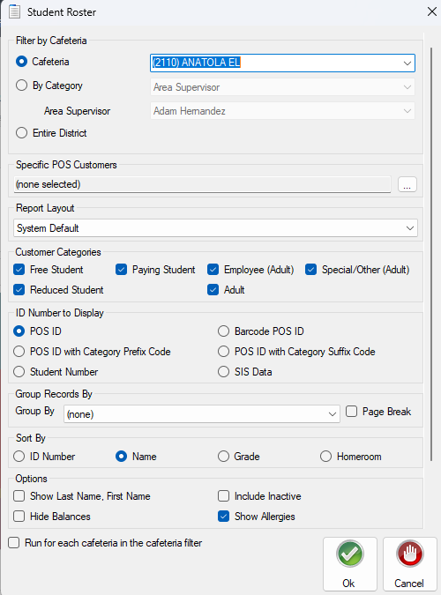
How to Print Student Rosters
1. From the ribbon, select Reports & Letters -> Customer Info -> Student Roster
2. The Student Roster window will open. Filter by Cafeteria name. Your cafeteria should be in the dropdown by default
3. Select the other options you would like: ID number, group by homeroom, sort by name or homeroom, etc.
4. Click “Ok”

Slide 2
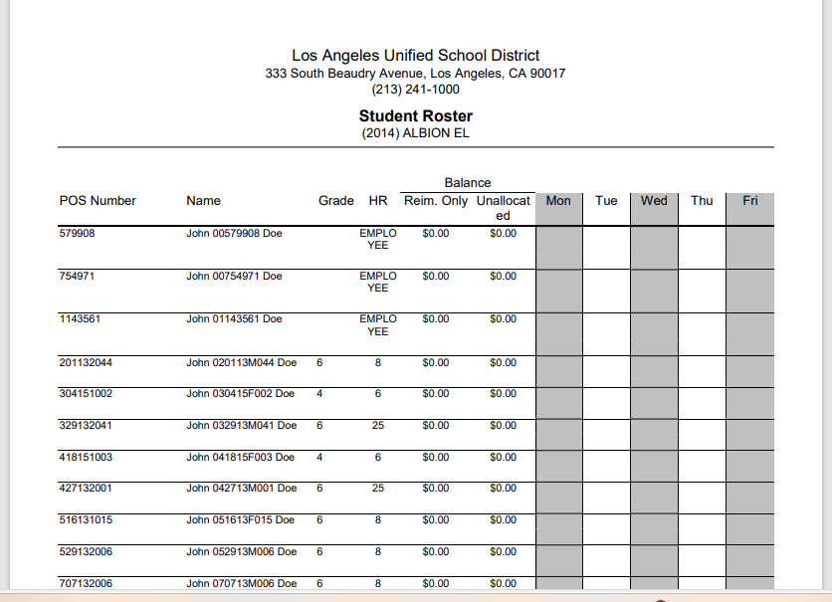
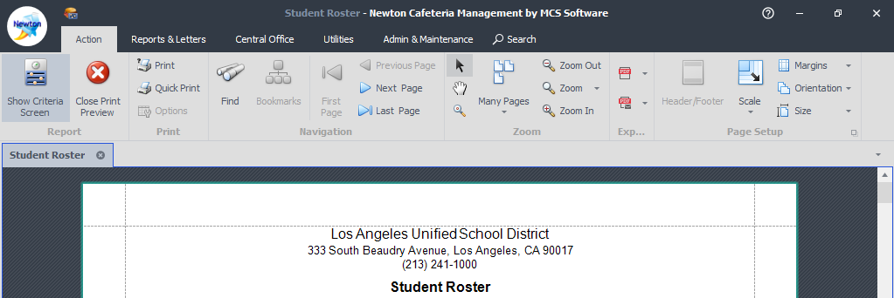
5. opt to print or export your report

